Slide 1
FPGA Accelerator application: Matrix Multiplication EE6900 : FPGA Accelerators Spring 2026 Professor: Dr. Yan Fang
Bota Yvan, Abhijeet Surakanti, Mason Snyder

Slide 2
Introduction – Why is it important
Matrix Multiplication is one of the most widely used computational primitives in modern computing
It is the backbone for deep neural network training and inference, with convolutional layers mapping naturally to GEMM operations
Applications go beyond machine learning
Linear algebra
Signal processing using transform domain filtering
Cryptographic protocols, especially lattice-based schemes
It is a ubiquitous across the industry and computationally intensive making it a prime target for acceleration.

Slide 3
Introduction – Computational Costs
Naïve multiplication of two N x N matrices requires O(N³) multiply-accumulate operations
For N = 1024 this exceeds 1 * 10⁹ operations per call which saturates CPUs under tight latency or throughput constraints
CPU’s currently use SIMD and GPU’s use massive threaded parallelism however,
Both consume significant power
Lack fine-grained architectural customizability for edge/embedded systems.

Slide 4
Introduction – Why FPGA’s?
FPGA’s offer post fabrication reconfigurability unlike the one and done style of ASICs
They allow for
Custom data paths with deterministic latency
Deeply pipelined MAC units
Tailored on-chip memory hierarchies optimized for specific access patterns
These features make FPGAs well suited for matrix multiplication
They achieve high throughput with a modest power consumption

Slide 5
Introduction – Role of High-Level Synthesis (HLS)
Traditional FPGA design with Verilog/VHDL is complex and time intensive
HLS tools allow hardware to be described in C/C++/SystemC
Designers can guide synthesis using pragmas for
Loop pipelining
Loop unrolling
Array partitioning
HLS reduces development time and lowers the barrier for entry into FPGA design

Slide 6
Introduction – What Are We Doing?
We start by creating a baseline HLS implementation of matrix multiplication
Apply and isolate the effects of three key optimizations
Compare resource utilization and performance across all design variants
Tiling
Pipelining
Unrolling
Demonstrate the value of HLS-based design exploration for intensive mathematical operations

Slide 7
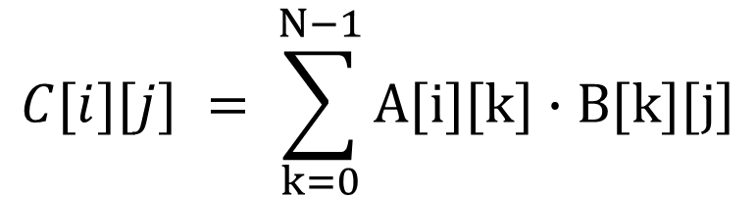
Background – Matrix Multiplication
Classic matrix multiplication uses a triple nested loop to compute each element of C[i][j]
Computational requirements
N³ MAC operations
2N³ memory reads
N² memory writes
$$C[i][j] = \sum_{k=0}^{N−1}{A[i][k]∙B[k][j]}$$
Equation 1
Notes:
Arithmetic intensity:
Naive implementation: O(1) (memory‑bound)
Tiled implementation: O(N) (can become compute‑bound)
Roofline model implication:
Naive algorithm is memory‑bound on systems with limited on‑chip storage.
Tiling improves data reuse, shifting the bottleneck toward compute and improving utilization

Slide 8
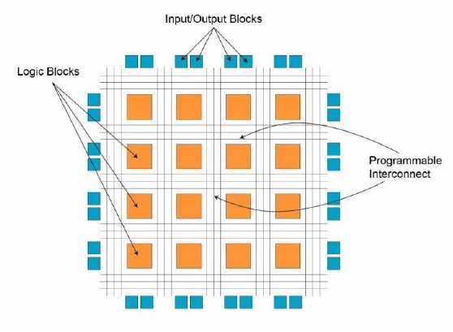
Background – FPGA Architecture
Modern FPGAs contain 4 main parts
CLBs with LUTs and flip-flops for general logic
DSP slices for high-speed MAC operations
BRAM tiles for dual-ported low latency on-chip memory
Programmable interconnect for routing signals between components
Figure 1: FPGA Architecture
Notes:
Architectural strengths:
High spatial parallelism via many concurrent processing elements.
Custom datapaths with deterministic latency.
Efficient for data‑parallel workloads like matrix multiplication

Slide 9
Background – HLS
Converts Runtime C/C++ to cycle accurate RTL
The stages are
Scheduling
Binding
Control Synthesis
Key HLS pragmas
PIPELINE
UNROLL
ARRAY_PARTITION
DATAFLOW
Notes:
Benefits:
Rapid design‑space exploration.
Modify a pragma → re‑synthesize in minutes.
Avoids rewriting complex RTL.

Slide 10
Background – Related Work
Y. Ma, Y. Cao, S. Vrudhula, and J.-S. Seo, “Optimizing the Convolution Operation to Accelerate Deep Neural Networks on FPGA,” IEEE Trans. Very Large Scale Integration (VLSI) Systems, vol. 26, no. 7, pp. 1354–1367, 2018.
K. Abdelouahab, M. Pelcat, J. Serot, and F. Berry, “Accelerating CNN Inference on FPGAs: A Survey,” arXiv preprint arXiv:1806.01683, 2018.
Collective conclusion:
FPGA achieve competitive throughput for matrix operations when memory access, buffering, and pipelining are optimized
Notes:
Systolic arrays remain a dominant architecture for FPGA GEMM acceleration.
Cong et al.: HLS can match hand‑optimized RTL when directives are applied effectively.
De Fine Licht et al.: communication‑avoiding GEMM using HLS; scalable across multiple FPGAs.
Ma et al.: optimized convolution (via im2col → GEMM) for CNN inference on FPGAs.
Abdelouahab et al.: survey of FPGA‑based CNN accelerators; tiled/pipelined GEMM is a recurring pattern.
Putnam et al.: demonstrated datacenter‑scale FPGA deployment for large workloads

Slide 11
Design Methodology
Algorithm specification in C++
HLS synthesis with Vitis
C/RTL co-simulation

Slide 12
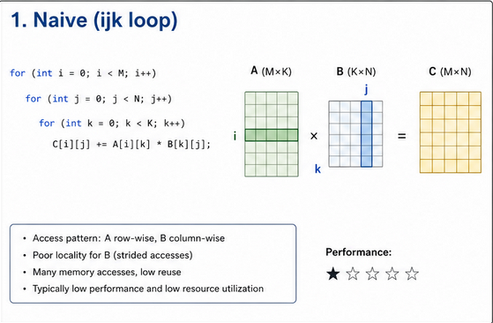
Baseline Design
Implements the naïve triple‑nested loop (i–j–k)
Computes one multiply‑accumulate (MAC) per cycle
Memory accesses occur directly from global memory

Slide 13
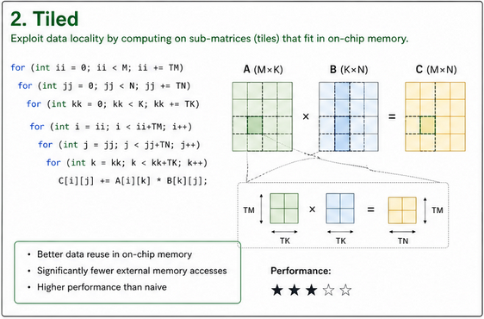
Optimized Designs – Tiled
Breaks matrices into smaller T × T sub‑blocks (Parallel MAC operations within each tile).
Loads tiles into local buffers (BRAM or registers).
Reduces global memory traffic significantly

Slide 14
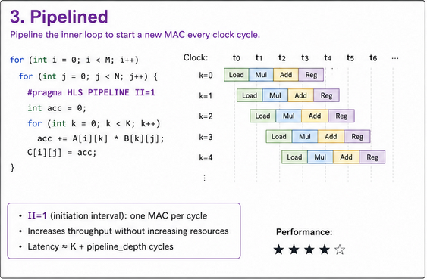
Optimized Designs – Pipelined
Applies #pragma HLS PIPELINE II=1 to inner loops
Allows a new iteration to start every clock cycle
The overlap operations improves throughput

Slide 15
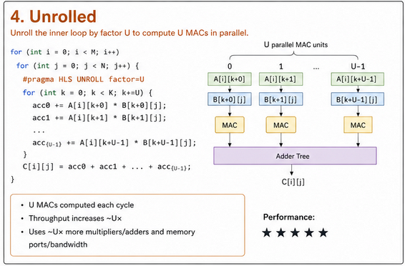
Optimized Designs – Unrolled
Applies #pragma HLS UNROLL factor=T to inner loops
Replicates hardware to compute multiple MACs in parallel
Creates a T‑wide MAC array

Slide 16
Experimental Setup
Target Platform
140 BRAM tiles (4.9 Mb)
220 DSP48E1 slices
Toolchain
Vitis HLS 2025.2
C simulation
C/RTL co-simulation
HLS synthesis
Target clock: 10ns (100 MHz)
Xilinx Zynq‑7020 SoC (xc7z020clg400‑1)
106,400 FFs
53,200 LUTs
Vivado 2025.2
Timing closure
RTL implementation

Slide 17
Results: Performance (N = 32, 100 MHz Clock)
Baseline
Latency: 0.164 ms
Throughput: 399 MFLOP/s
Speedup: 1.0x
Tiled (T=16)
Latency: 0.05264 ms
Throughput: 1,244 MFLOP/s
Speedup: 3.12x
Pipelined (T=16)
Latency: 0.05256 ms
Throughput: 1,247 MFLOP/s
Speedup: 3.12x
Tiled + Unrolled (T=32)
Latency: 0.02060 ms
Throughput: 3,180 MFLOP/s
Speedup: 7.96x
Best-performing design

Slide 18
Results: Resource Utilization (Zynq-7020)
Baseline
Minimal LUT/FF usage
6 DSPs
0 BRAM
Tiled (T=16)
48 DSPs
0 BRAM
Moderate LUT/FF growth
Tiled + Pipelined
Similar to Tiled
Tiled + Unrolled
Small overhead for pipeline registers
LUTs: 12,686
FFs: 75,126
DSPs: 96
BRAM: 64

Slide 19
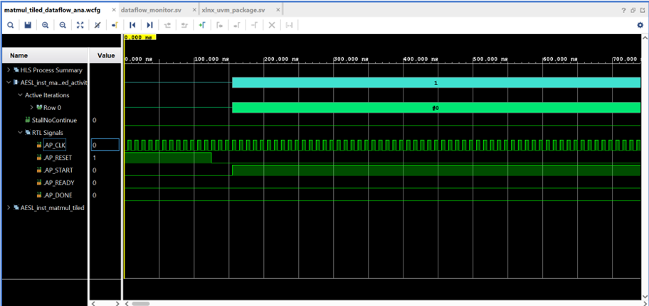
C/RTL Co-simulation Waveform Analysis
Figure 2: Waveform Analysis

Slide 20
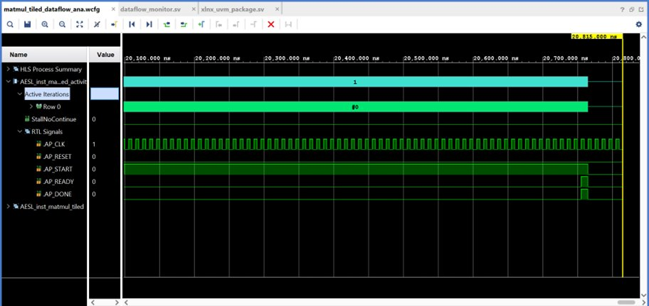
C/RTL Co-simulation Waveform Analysis
Figure 3: Waveform Analysis

Slide 21
Conclusion
Key Takeaways
Successfully designed and optimized an FPGA-based matrix multiplication accelerator using Vitis HLS
Explored 4 architectural variants: Baseline, Tiled, Pipelined, and Unrolled
Performance Gains
Tiling significantly reduced DDR access overhead and improved data locality
Pipelining achieved II=1, increasing compute throughput with minimal resource overhead
Unrolling maximized parallel MAC operations, delivering the highest speedup (7.96x) and 3.18 GFLOP/s throughput
Best-performing design: Unrolled (N=32, T=32)

